Slide 1
Questions on “The Problem of Social Cost”

Slide 2
Reminder: Short Paper
You are arguing a case before Judge Posner. Write a brief argument for one side based on law and economics arguments. Any case past or present will do, provided it is not covered in either my book or Posner’s Economic Analysis of Law, which I will put on reserve so you can check.

Slide 3
Review of “The Problem of Social Cost”

Slide 4
“Externalities” are Jointly Caused

Slide 5
Price Theory Framework
Cost of inputs=their value in the best alternative use
Price of outputs=their value to those who buy them

Slide 6
Farmer and Rancher
The outcome does not depend on who is liable
And is efficient
Provided transaction costs are zero

Slide 7
With zero transaction costs, it never pays to leave money on the table.
With non-zero transactions costs, it pays to leave money on the table if the amount of the money is less than the cost of picking it up.

Slide 8
More Cases, the Same Logic
Confectioner vs Doctor
Bleaching Coconut Matting
Blocking the draft of a chimney
Jolly Angler Brewing

Slide 9
Judge’s Basis for Deciding the Case
May Seem Irrelevant to the Economist
But
It may be designed to give a predictable rule
Or be a proxy for relevant considerations

Slide 10
Two Alternative Approaches
Two alternatives:
  Court find least cost avoider each time
  Or court or legislature makes rules
  Designed to usually make the lower cost avoider liable
The first alternative can give results better fitted to cases, but …
Reduces certainty, raises litigation costs, makes transactions harder
This is an extreme version of the “rule vs standard” issue
Speed limit or a law against dangerous driving

Slide 11
Possible solutions to the transaction costs of the market
Combine activities in a firm
Have government regulation
Do nothing
All have costs, so it is a matter of choosing the least bad

Slide 12
Coase’s Advice to Economists
Gather data on how transactions are organized

Slide 13
Where transaction costs are high, court decisions matter.
In the limit of infinite transaction costs, we are back in a Pigouvian world
With the Coaseian critique about double sided causation still valid
Property rule if it is clear what the right answer is
Liability rule if it is unclear what the right answer is, but damages can be measured
Leaving the question of which party is liable and/or which holds the property right

Slide 14
Common Law of Nuisance vs Statute
Statute may expand or contract the coverage of the law of nuisance
Examples?

Slide 15
Pigou and Railroads
State action is needed; what additional state action?
But Pigou’s railroad example is due to state action, and ...
Not necessarily undesirable.
Let them grow clover

Slide 16
What is Owned is a Right, not a Thing

Slide 17
Further Points
The existence of inefficiency relative to the outcome produced by a perfectly wise planner does not necessarily mean you are doing anything wrong and government should step in
And “government stepping in” is not well defined.
Since the government defined the rights you start with

Slide 18
Actually very little analysis is required to show that an ideal world is better than a state of laissez faire, unless the definitions of a state of laissez faire and an ideal world happen to be the same. But the whole discussion is largely irrelevant for questions of economic policy since whatever we may have in mind as our ideal world, it is clear that we have not yet discovered how to get to it from where we are. A better approach would seem to be to start our analysis with a situation approximating that which actually exists, to examine the effects of a proposed policy change and to attempt to decide whether the new situation would be, in total, better or worse than the original one. In this way, conclusions for policy would have some relevance to the actual situation.

Slide 19
Risk
Risk aversion is not about risk
Moral hazard is not about morality
Labels say less than they pretend

Slide 20
The Utility Function
A description of preferences
Over anything—apples, books, money, girlfriends, …
  If U(3,4,$3000, Mary) > U(2,6,$1000, Anne)
  You would rather have … 3 apples, 4 books, $3000, and Mary as your girlfriend than …
But we will be looking at the utility of income
Which can be used to buy (almost) anything.

Slide 21
Utility of Income
U($50,000) > U($40,000) > U($30,000)
But how much greater?
Is [U($50,000) - U($40,000)] more or less than U($40,000) - U($30,000)

Slide 22
Why?

Slide 23
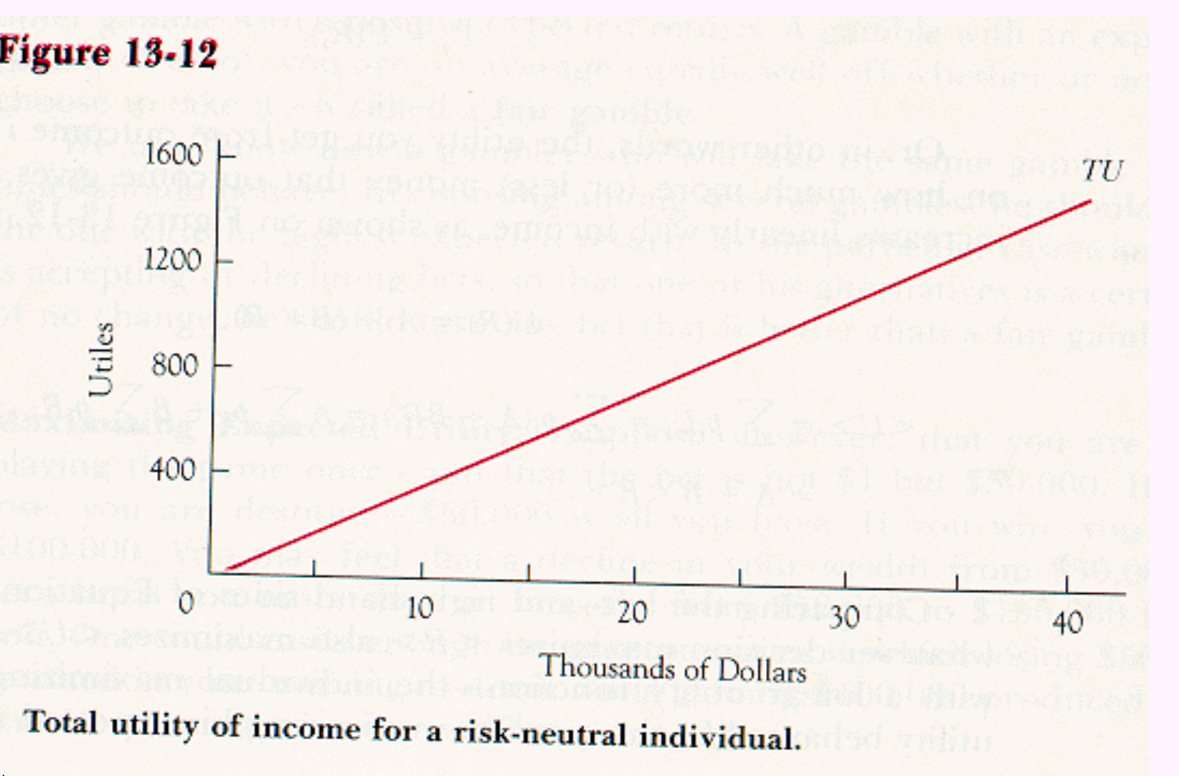

Slide 24
Declining Marginal Utility of Income

Slide 25
DMU=Risk Aversion

Slide 26
“Risk Aversion”=DMU(I)=Risk Aversion in Income
One might be risk averse in income, risk preferring in length of life.

