Slide 1
Sustainability: Empty Rhetoric or a Bad Idea?

Slide 2
Empty Rhetoric

Slide 3
Sustainable: capable of being sustained

Slide 4
"meeting the needs of the present without compromising the ability of future generations to meet their needs”

Slide 5
"A dynamic state in which global ecological and social systems are systematically enhanced. Sustainable development is often defined as that which meets the needs of the present without compromising the ability of future generations to meet their needs. Sustainability is often evaluated using the ‘triple bottom line’ for ecological, social, and economic health because economic considerations are such a large and central aspect of social systems, and vital to the continued operation of individual organizations."

Slide 6
Or a Bad Idea

Slide 7
http://geology.com/sea-level-rise/

Slide 8
Prediction is hard, especially about the future
Yogi Berra

Slide 9
George Orwell, 1946
"Necessarily the figures are uncertain, but it is quite possible that in only seventy years our population will amount to about eleven millions, over half of whom will be Old Age Pensioners.”

Slide 10
Paul Ehrlich, 1968
“The battle to feed all of humanity is over. In the 1970's the world will undergo famines--hundreds of millions of people are going to starve to death in spite of any crash programs embarked upon now.”

Slide 11
According to a report published by the United Nations University, there are now about 19.2 million people officially recognized as "persons of concern"-that is, people likely to be displaced because of environmental disasters. This figure is predicted to grow to about 50 million by the end of the year 2010.
It could lead to 50 million people, the equivalent of the population of England, becoming environmental refugees by 2010, a senior UN official warned last night.
Dr Yvo de Boer, executive secretary of the UN convention on climate change, said the number of environmental refugees — from deforestation and desertification as well as climate change — was likely to exceed the number of traditional refugees by the end of the decade.

Slide 12
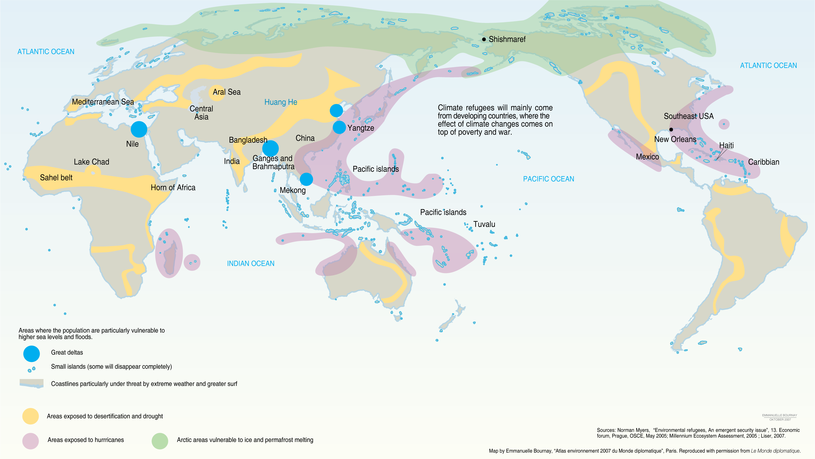

Slide 13
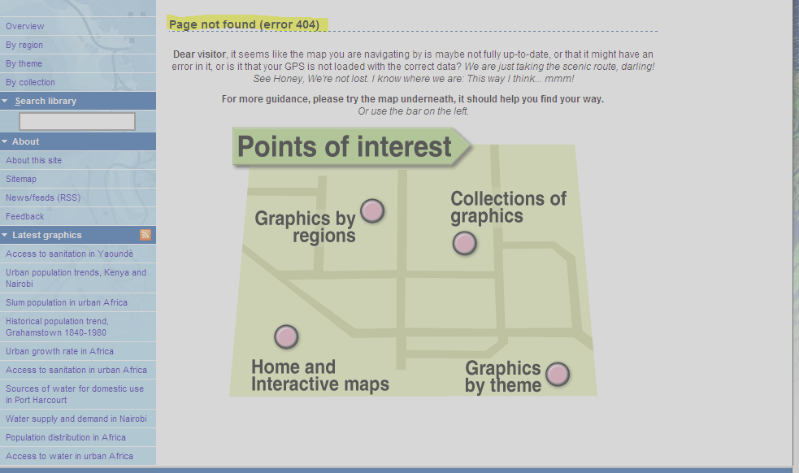

Slide 14
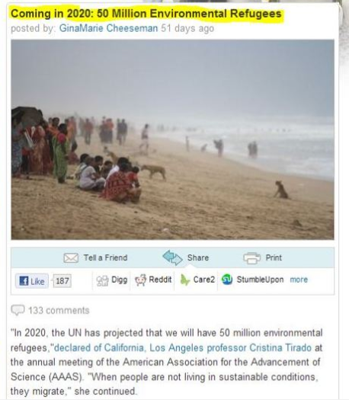

Slide 15
Gore on Biofuels
"It's hard once such a program is put in place to deal with the lobbies that keep it going."
…
"One of the reasons I made that mistake is that I paid particular attention to the farmers in my home state of Tennessee, and I had a certain fondness for the farmers in the state of Iowa because I was about to run for president."

